Slide 1




REST easy
Jimmy Bogard
@jbogard
github.com/jbogard
jimmybogard.lostechies.com

Slide 2
7 stages of REST grief

Slide 3

Stage 1: WTF is this I don’t even

Slide 4

Stage 2: Oh ok it’s like CRUD but webby

Slide 5

Stage 3: REST ALL THE THINGS

Slide 6

Stage 4: Wait my API isn’t RESTful?

Slide 7

Stage 5: Ohhhhhh I get it, HATEOAS and stuff

Slide 8

Stage 6: Am I just reinventing a browser?

Slide 9

Stage 7: I guess it’s useful sometimes

Slide 10

Problem #1: Nobody knows what REST really is except for like one dude

Slide 11
REST is… constraints and stuff

Slide 12
REST: the good parts Hypermedia

Slide 13
What’s wrong with plain ol’ JSON objects? (POJSONO)

Slide 14
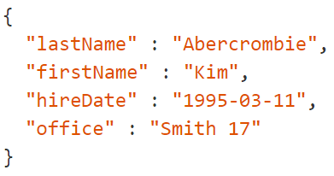
Mo’ POJSONO problems
Labels/names hardcoded
Types inferred
What can I do with this?
What is related to this?

Slide 15
Hypermedia = JSON + Links + URLs + Forms/Queries

Slide 16
Where is hypermedia applicable?

Slide 17
Normal app – probably not
Browser
Server
HTML
JavaScript
AJAX

Slide 18
Disparate clients - yes
App V1
Server
App V2

Slide 19
Disparate servers - yes
App
Server V1
Server V2

Slide 20
Mobile apps - perhaps
Mobile Device
App Store
App.ipa
Server
AJAX

Slide 21
Common theme: Client/server developed/deployed independently

Slide 22
Choosing a hypermedia format
Build your own
Pick a standard
Hybrid – pick a standard and extend

Slide 23
Some examples

Slide 24
HAL

Slide 25
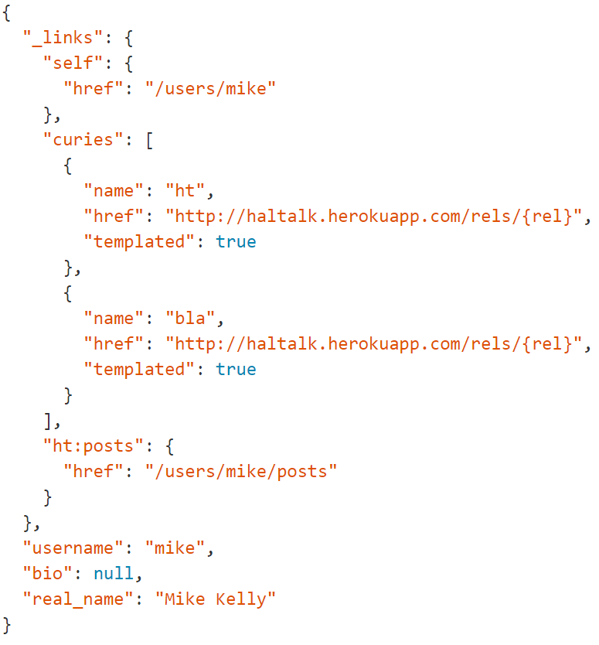

Slide 26
collection+json

Slide 27
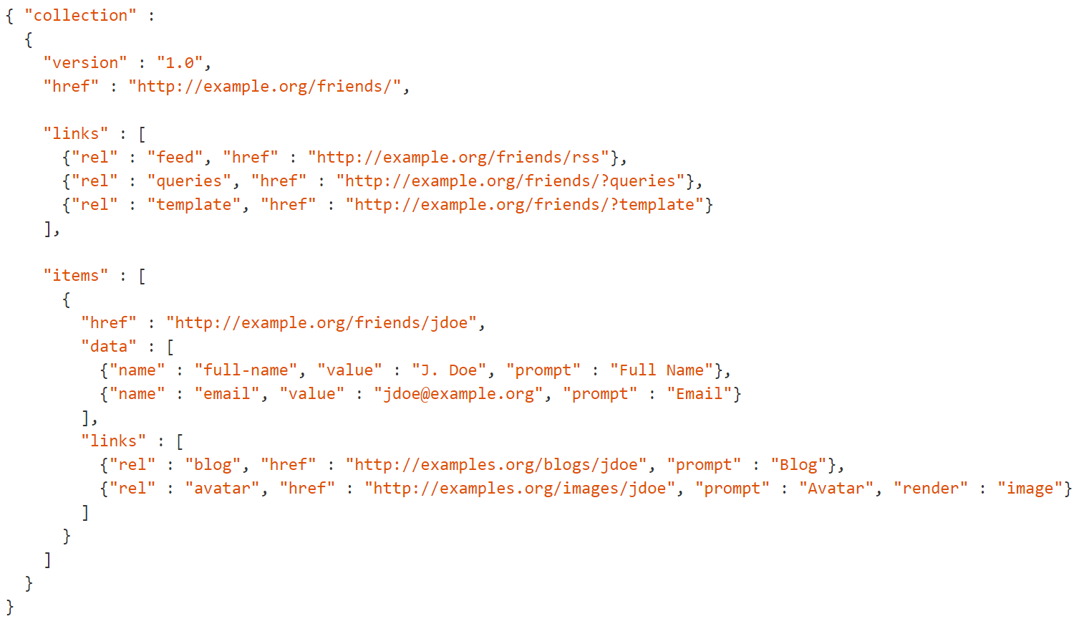

Slide 28
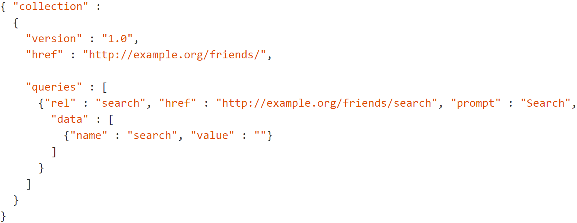

Slide 29
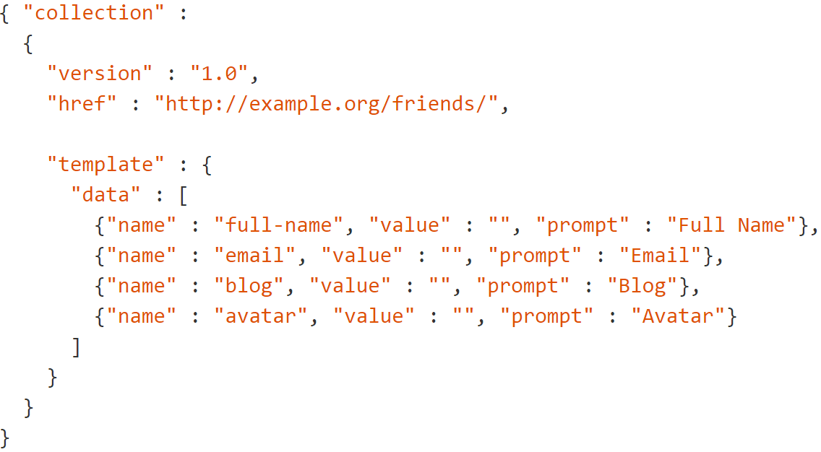

Slide 30
Siren

Slide 31
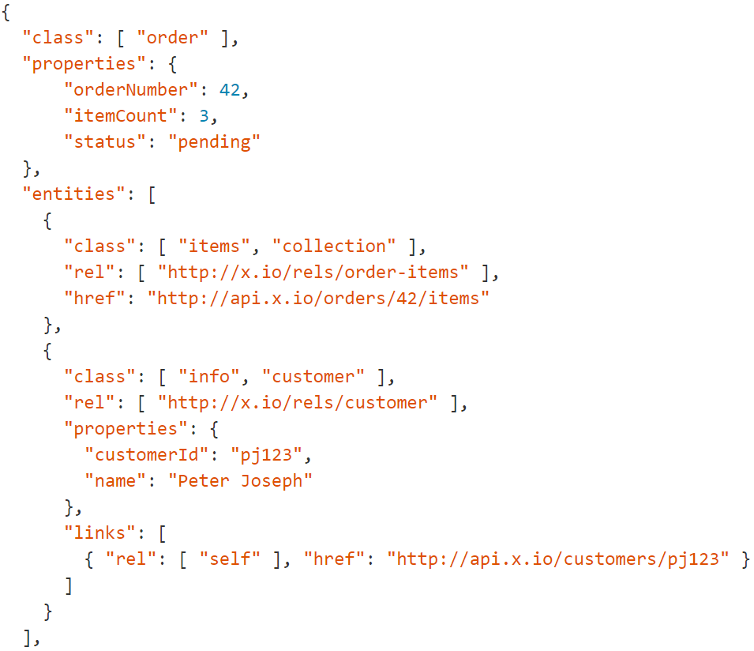

Slide 32
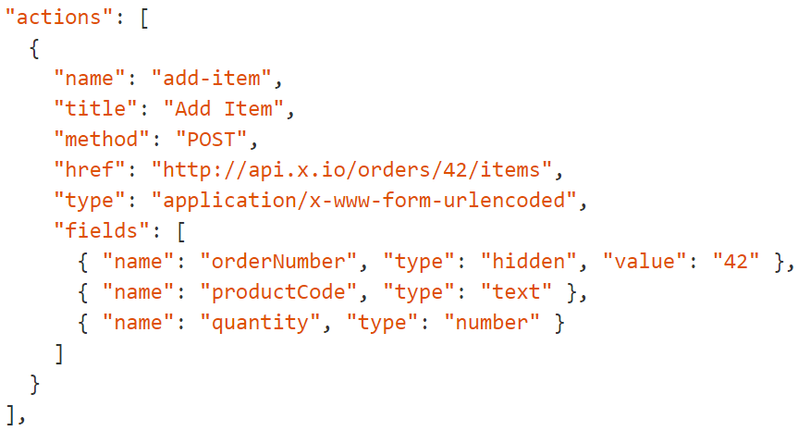

Slide 33
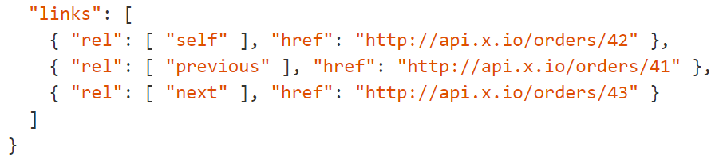

Slide 34
JSON+LD and Hydra
Notes:
http://www.markus-lanthaler.com/hydra/

Slide 35
Problem #2: No hypermedia format will solve all of your problems

Slide 36
Problem #3: Consuming hypermedia APIs is harder than POJSONO APIs

Slide 37
Demo: collection+json

